Slide 1









DDR5 DIM
Sub-Channel
Each chip is 4-bit wide
x 16-bit deep
4x2
Width : 4
Rank Design
BL : 2
Chipkill이 아니다.
CW (80,64,16)
RS (10,8,8)
8x1
CW (40,32,8)
RS (5,4,8)
Codeword
Dataword
Symbol size
64bits
per chip
GF($2^{8}$)
4x2
8x2
8 data chips
CW (80,64,16)
RS (10,8,2)
CW (80,64,16)
RS (5,4,16)
2 ECC chips
SSC
GF($2^{8}$)
GF($2^{16}$)
2x4
4x4
8x4
CW (160,128,32)
RS (20, 16, 4)
CW (160,128,32)
RS (10,8,2)
CW (160,128,32)
RS (5,4,32)
DSC
SSC
GF($2^{8}$)
1x8
GF($2^{16}$)
2x8
4x8
8x8
GF(2^32) 구현이 어렵다.
GF($2^{32}$)
QSC
CW (320,256,64)
RS (40, 32, 8)
DSC
CW (320,256,64)
RS (20, 16, 4)
CW (320,256,64)
RS (10,8,2)
CW (320,256,64)
RS (5,4,64)
GF($2^{16}$)
1x16
GF($2^{32}$)
GF(2^32) 구현이 어렵다.
2x16
CW (640,512,128)
RS (20, 16, 4)
GF($2^{64}$)
4x16
CW (640,512,128)
RS (20, 16, 32)
CW (640,512,128)
RS ( 40, 32, 8)
GF(2^64) Primitive polynomial 구현이 어렵다.
QSC

Slide 2
2 x 8
4 x 4
1 x 16
On-Die Bound
16bit bound
1 x 32
2 x 16
4 x 8
32bit bound
On-Die Un-Bound
이것도 추가

Slide 3
Error Types
의 위치는 조건 내에서 랜덤
DQ: 0 1 2 3
0 1 2 3
0 1 2 3
0 1 2 3
un-bound
128bits
per chip
bound
1. 1-bit
2. Bounded-muti-bit
(Parity 제외)
(Bound는 random)
3. Bounded-muti-bit
(Parity 제외)
(Un-bounded OD-ECC 경우에는 MBBE 6가지 경우 각각 다 돌리기)
4. 1-word (all 4bits)
→ 같은 BL 내 4bit , BL 은 random
5. Chip (All random)
Parity부분에서 발생한 multi-bit error는
boundary가 보장되지 않는다.
따라서, Bounded error의 경우에는 parity에서
error를 발생시키지 않고 실험을 돌린다.
Bounded error에 대한 reliability 확인이 목적이기 때문!
bound
bound
6. 1Pin
(Pin은 random)
7. 1Pin
+ 1bit (un-bound)
8. 1Pin
+ 1bit (bound)

Slide 4
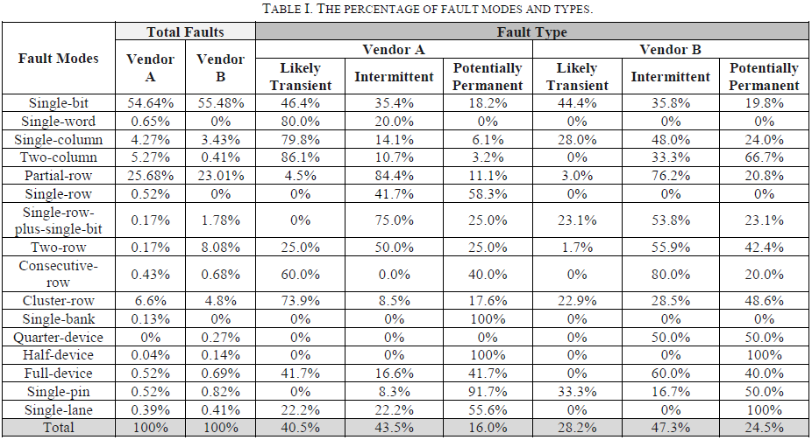
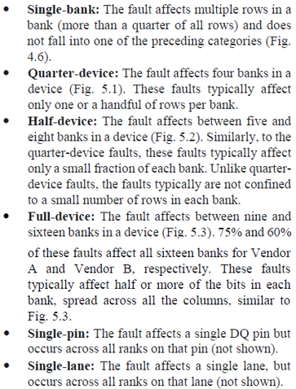
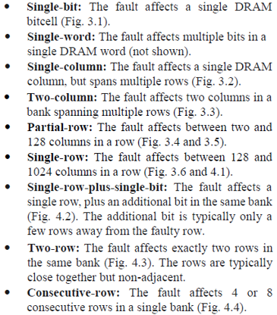
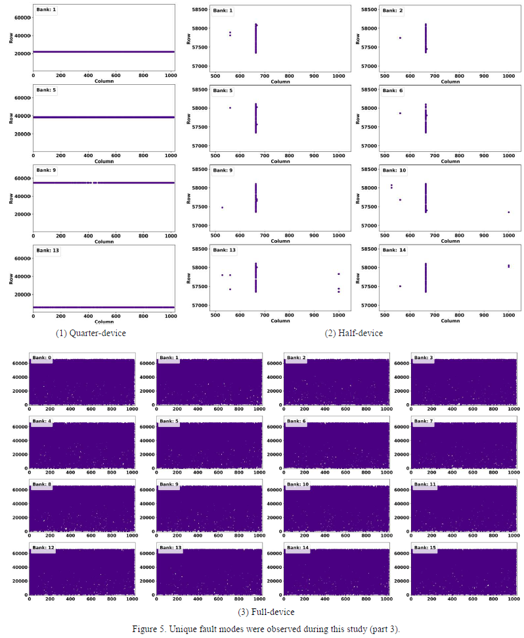
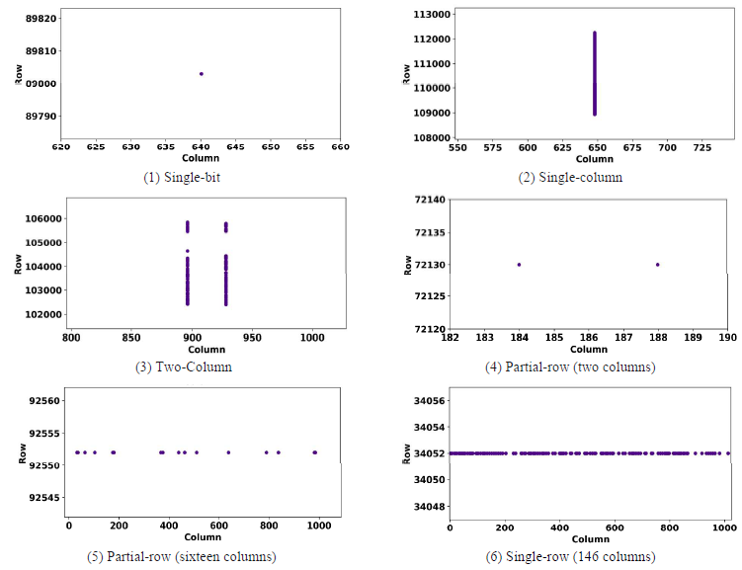
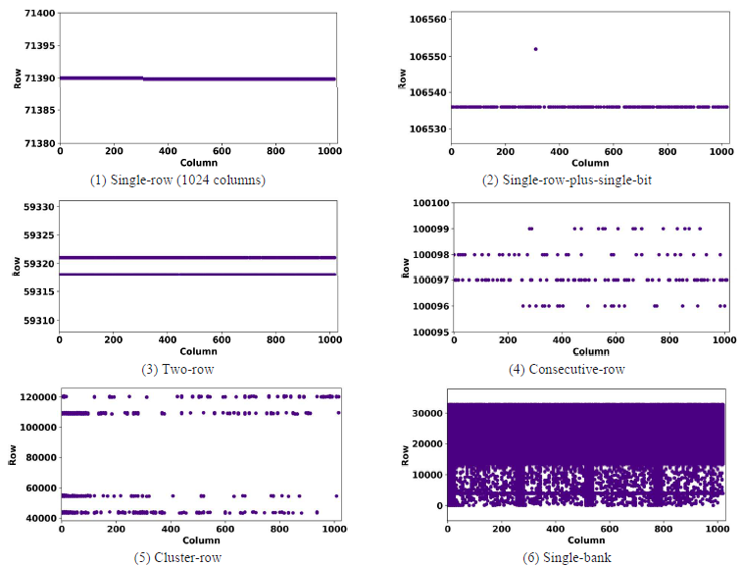

Slide 5
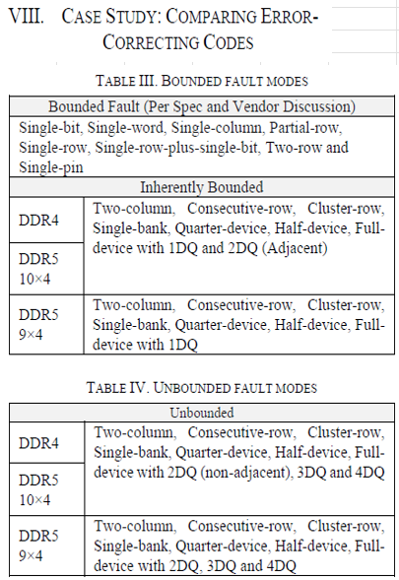
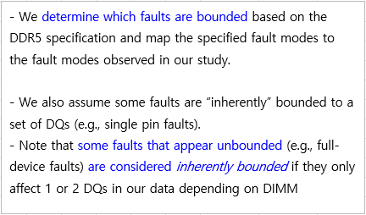

Slide 6
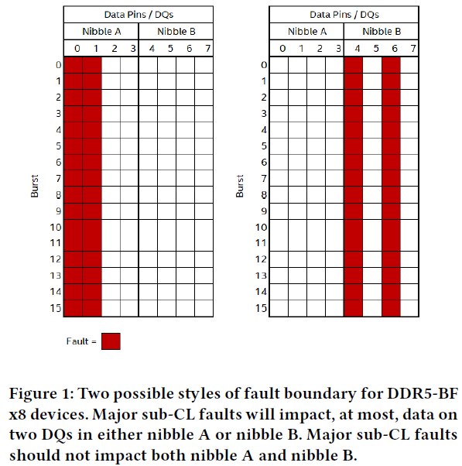
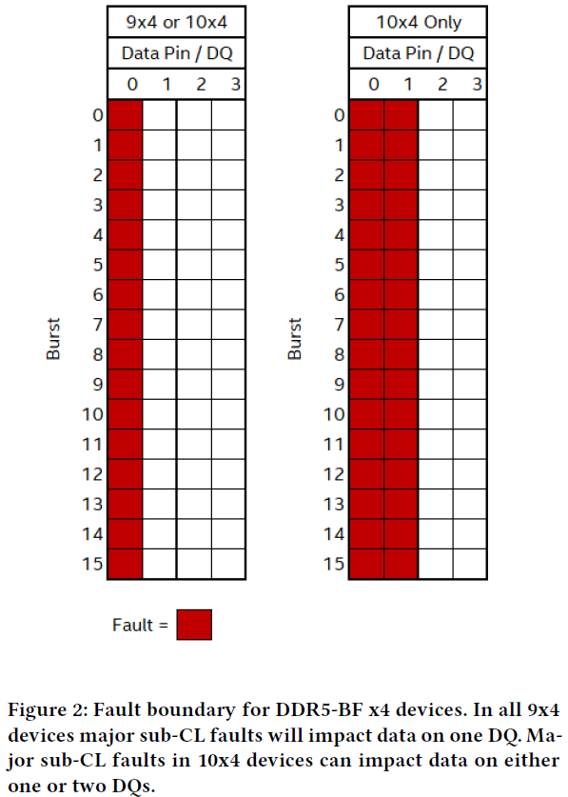
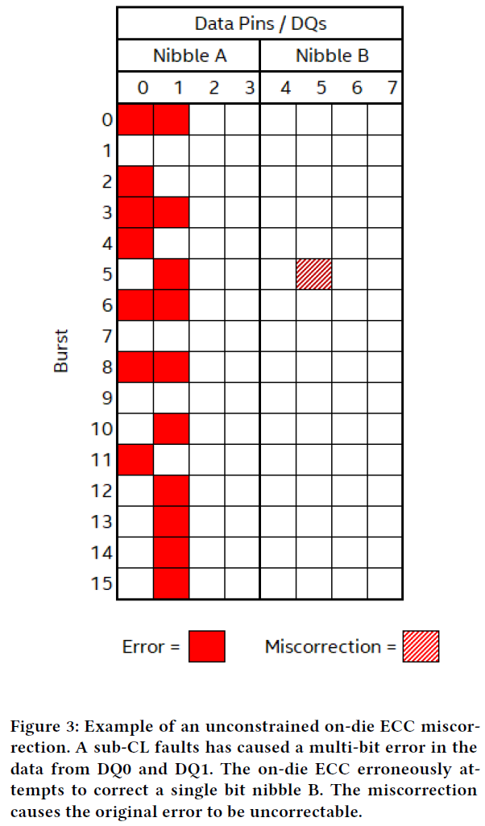
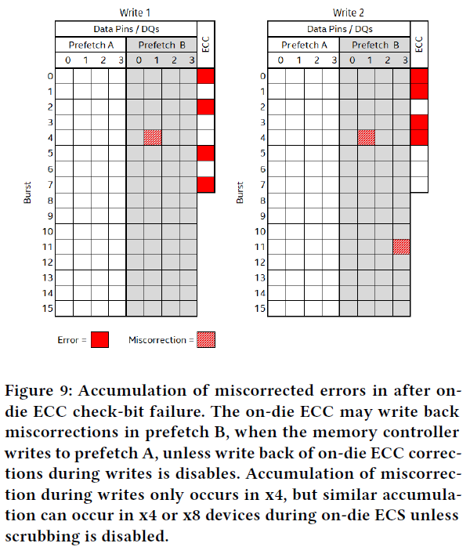
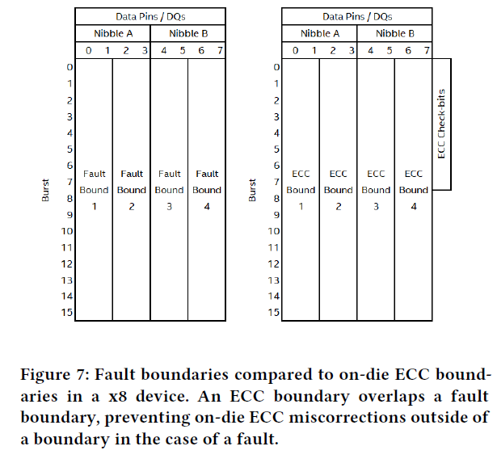
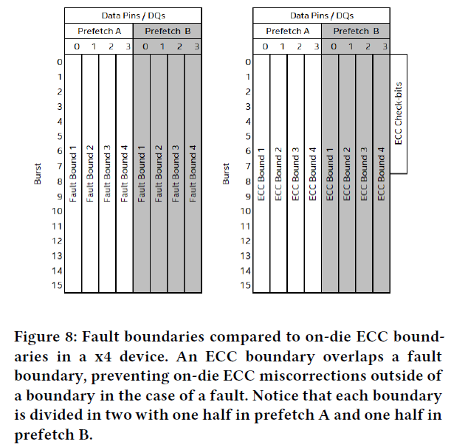

Slide 7
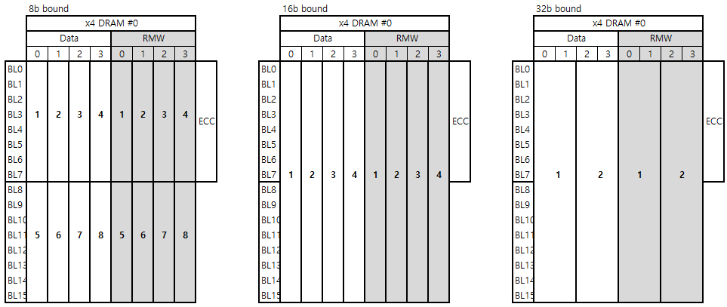
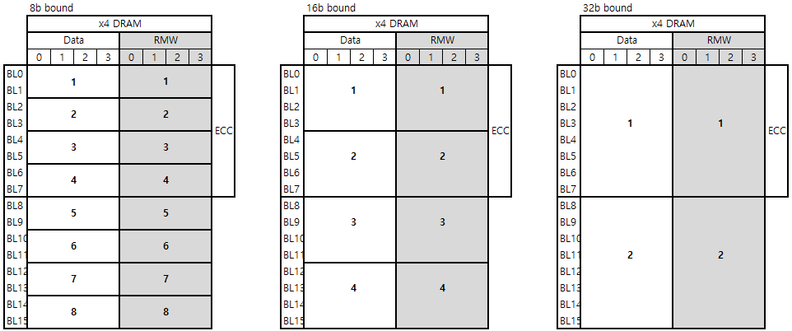
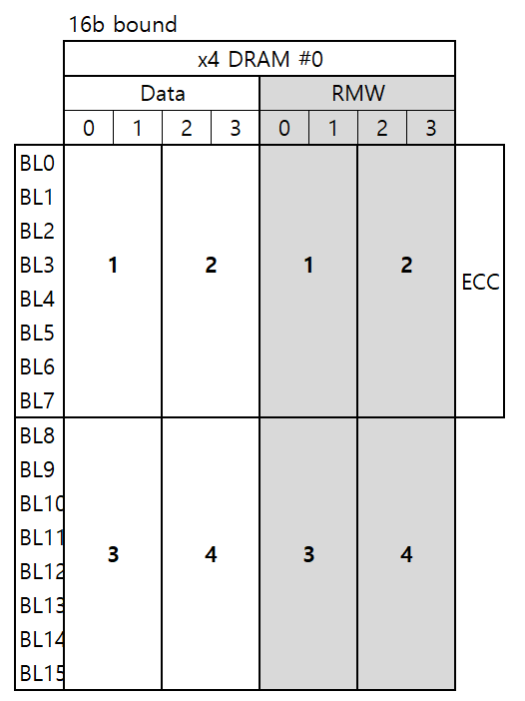
On-Die Bound
1X8
1X8
1X8
1X8
CW (320,256,8)
RS (40,32,8)
0
3
0
64
4X2
CW (80,64,8)
RS (10,8,8)
7
4X4
2X4
2X4
CW (160,128,8)
RS (20,16,8)
CW (160,128,16)
RS (10,8,16)
60
63
127
4X8
2X8
2X8
X
CW (640,512,32)
RS (10,8,32)
CW (320,256,16)
RS (20,16,16)
2
X
16
2
X
16
1X16
1X16
1X16
1X16
CW (640,512,32)
RS (20,16,32)
CW (640,512,16)
RS (40,32,8)

Slide 8
Rank Design
1X8
1X8
1X8
1X8
CW (40,32,8)
RS (5,4,8)
CW (80,64,16)
RS (10,8,8)
2X4
2X4
CW (160,128,32)
RS (20,16,8)
CW (320,256,64)
RS (40,32,8)
4X2
8X1
1X16
1X16
1X16
1X16
2X8
2X8
CW (80,64,16)
RS (5,4,16)
4X4
CW (160,128,32)
RS (10,8,16)
CW (320,256,64)
RS (20,16,16)
CW (640,512,128)
RS (40,32,8)
8X2
1X32
1X32
1X32
1X32
2
X
16
2
X
16
4X8
8X4
CW (160,128,32)
RS (5,4,32)
CW (320,256,64)
RS (10,8,32)
CW (640,512,3128
RS (20,16,32)
CW (1280,1024,256)
RS (40,32,32)

